Slide 1
Sardis Elementary Title I Annual Meeting
September 28, 2023

Slide 2
Federal Requirements
The Every Student Succeeds Act (ESSA) requires that each Title I school hold an Annual Meeting for the purpose of…
Informing you of your school’s participation in Title I.
Explaining the requirements of Title I.
Explaining your rights as parents to be engaged in the school community.

Slide 3
Meeting Overview
What is Title I?
What does it mean to be a Title I school?
Our School’s Proud Points from 2022-2023
Our School’s Goals for 2023-2024
How Title I funds are Used at Our School
Your Rights as Parents and Families
School Improvement Planning
Parent and Family Engagement Policy
School-Parent Compact
Your “Right to Know”

Slide 4
What is Title I?
Title I is the nation’s oldest and largest federally funded educational program.
Title I provides supplemental funds to schools to help students meet their educational goals.

Slide 5
What does it mean to be a Title I school?
Being a Title I school means receiving federal funding to supplement the school’s existing programs. This funding is used for…
Identifying students experiencing academic difficulties and providing timely assistance to help them meet the State’s challenging content standards.
Purchasing supplemental programs, materials, and/or supplies.
Conducting parent and family engagement meetings, trainings, and activities.
Being a Title I school also means encouraging parental engagement and advocating for parents’ rights.

Slide 6
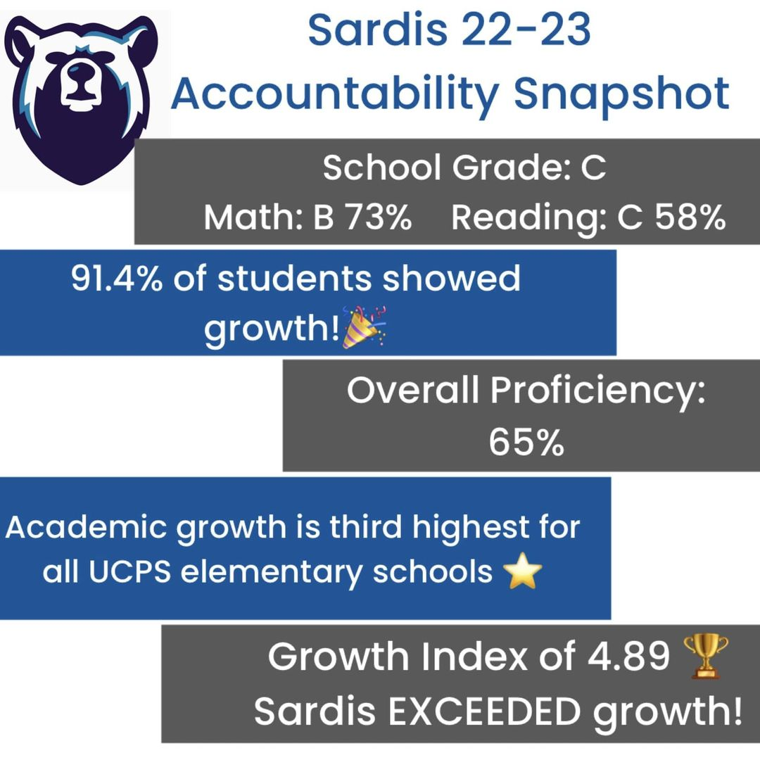
Our School’s Proud Points from 2022-2023
Exceeded Growth for a Second Year!
Rebranding, new bear – Sarge!
Growing PTO!
Doubled our amount of students exiting ML program on WIDA
Our PAW System:
Practice Responsibility
Always be Respectful
Work & Play Safely

Slide 7
Our School’s Goals for 2023-2024
Safety | Academics | Culture
Goal: Ensure that all students feel: Safe A sense of belonging They have a voice and are supported Decrease discipline referrals (less than 65 for the whole year) | Goal: Increase 23-24 EOG proficiency Reading from 51% to 60% Math from 69% to 78% Science from 78% to 85% Exceed Growth for a Third Year in a Row & get back to being a B school | Goal: Evidence of new mission statement across the whole school community: LEADING WITH PURPOSE Increase leadership opportunities for PreK-5 students

Slide 8
How Title I Funds are Used at Our School
5 Classroom Teacher Positions
Kindergarten, 1st grade, 2nd grade, 3rd grade, and 4th grade
Interventionists
Teaching Assistant
Parent & Student Involvement (treats and learning resources)
Learning Resources and Curriculum Materials
Professional Development Opportunities for Teachers

Slide 9
Your Rights as Parents & Families of a Title I School
You have a right to be involved in the following:
Development of the…
School Improvement Plan/NCStar Plan
Parent and Family Engagement Policy
School-Parent Compact
Title I funding allocations for parent and family engagement.

Slide 10
School Improvement Plan/NCStar Plan
The School Improvement Plan/NCStar Plan includes:
A Comprehensive Needs Assessment
Goals and Strategies to Address Academic Needs of Students
Professional Development for School Staff
Coordination of Resources and a Comprehensive Budget
The School’s Parent and Family Engagement Goals
Parents and families at Title I schools have the right to be engaged in the development of this plan.

Slide 11
Parent and Family Engagement Policy
Every Title I School must have a School Parent and Family Engagement Policy that is jointly developed with parents and families.
The school Parent and Family Engagement Policy outlines how the school will implement the parental engagement requirements of the Every Student Succeeds Act (ESSA). Components include:
How parents can be involved in decision-making activities.
How information on instruction and assessment will be provided to parents.
How the school will build parents’ and families’ capacities for supporting their children’s learning at home.
How parental involvement funds are being used.
Parents and families at Title I schools have the right to be involved in the annual review and improvement of the Parent and Family Engagement Policy.

Slide 12
How Our School will Engage
Parents and Families
School Events throughout the school year
Music Performances and Related Arts Showcase– grouped grade levels through the year
Student Showcases
Family Fun Night
…other things are in the works
PTO Events
Parent Committees
Turkey Trot
Dollar Days
Upcoming Dances
…and many more events planned
Parent and Teacher/School Communications
conferences and informal interactions
Dojo and Social Media sites
Connect Ed messages

Slide 13
School-Parent Compact
Every Title I School must have a School-Parent Compact that is jointly developed with parents and families.
The compact is a commitment or contract between the school, teacher, parent, and student to share in the responsibility for academic achievement.
The compacts must be distributed to all parents and families.
Parents and families at Title I schools have the right to be engaged in the annual review and improvement of the School-Parent Compact.

Slide 14
Your “Right to Know”
You, as a Title I parent/family, have the right to request…
the qualifications of your child’s teachers.
information about any state or local policy regarding student participation in any assessments mandated by the state or local district.
The Right to Know notification is distributed to all students at the beginning of the school year and is posted on our school’s website.
You, as a Title I parent/family, will be notified if your child is instructed for four or more consecutive weeks by a teacher who does not meet the North Carolina state licensure requirements for the grade level or subject area that he/she is teaching.

Slide 15
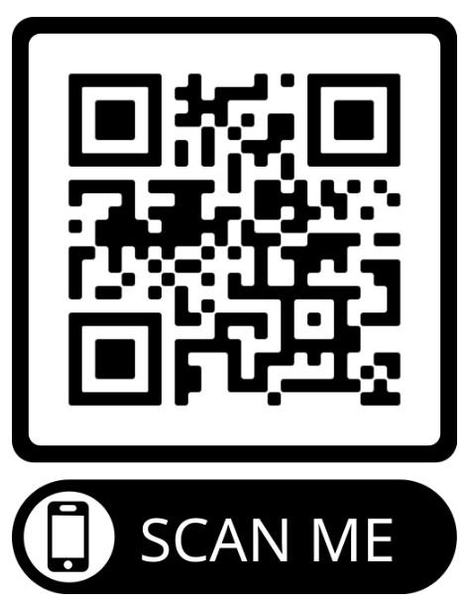
Questions & Answers
Please use the QR Code to ask any questions you may have & we will get back to you!

Slide 16
Title I Department Staff Contact Information
Director of Federal Programs
Dr. Elenia Daniels
elenia.daniels@ucps.k12.nc.us
Title I Specialist
Paulette Pipkin
paulette.richardsonpipkin@ucps.k12.nc.us
Title I Specialist
Lori Spruiell
lori.spruiell@ucps.k12.nc.us

